Slide 1
General Report
March, 2021

Slide 2
Executive Summary…
The aim of STREAM, University Student Capacity Building: Towards Readiness for Sustainable Development-Oriented Regional Job Market, a Co-funded Erasmus+ Project, is to introduce a role model for reforming the learning environment at HE institutions in the MENA region towards increasing the readiness for its graduate to engage effectively in the society. The project starts with survey questionnaires to assess the current university graduate skills, qualifications and competencies in the partner countries in the project Egypt, Jordan, and Algeria) with an overview of those in other countries in the MENA region. Graduates from Engineering & technology-ITC (tow most populated tracks) were investigated.
The skills surveyed mapped the following categories:
Personal skills
Social skills
Analytical skills
Cognitive skills
Intellectual skills
In order to identify key graduates’ competencies as required by the job market and how teaching practices can reduce the competencies gap, 3 different survey questionnaires were designed and administrated in partner countries to targeted participants:
1.1 Survey on current students’ qualifications: current university graduate skills, qualifications and competencies in the partner countries in the project with and overview of those in the countries in MENA region. This survey was disseminated among senior university students of and graduates from Engineering & technology – ITC.
1.2 Survey on regional job-market needed graduates’ competencies in each partner country and what the employers are seeking in fresh graduates. This survey was distributed among employers, managers, trainers, and HR personnel in two different market segments – engineering and technology.
1.3 Survey on current teaching/learning methodologies at particular partner institutions that had led to the outcomes in 1.1. This survey was administrated to universities’ faculty members at partner universities.
The findings will be the guide for a Gap Analysis of current and future students’ qualifications and the market needed competencies, which will be, in turn, the basis of the design of Student Journey throughout the academic Lifecycle at the university level. This will yield a roadmap mapping targeted competencies with curricular and extra-curricular activities over the academic years, identifying which to be covered in-class and which out-of-class, and which through project-based learning.

Slide 3
Key Findings…
The following is a summation of the findings compiled from the respondents:
Survey 1.1
Cognitive Skills had the highest average in the MENA region
Capacity to follow specific rules had the highest average for the cognitive skills package, followed by Ability to multitask, while capacity to learn scored the lowest average.
Intellectual Skills came next with the second-highest average in the MENA region
Research skills had the highest average for the intellectual skills package, followed by Digital competencies and computer skills. Grounding in basic knowledge of the profession in practice scored the lowest average.
Survey 1.2
Cognitive Skills and Social Skills had the highest average in the MENA region
Cognitive: Capacity to learn had the highest average for the cognitive skills package, followed by Ability to analyze problems and evaluate option, and Capacity to follow specific rules scored the lowest average
Social: Ability to work in an interdisciplinary team had the highest average for the social skills package, followed by teamwork, Communication at all levels and interpersonal skills (also conflict resolution and negotiation skills) scored the lowest average.
Intellectual Skills came next with the second-highest average in the MENA region
Grounding in basic knowledge of the profession in practice and Digital competences and computer skills had the highest average for the intellectual skills package, and were followed by Research skills.

Slide 4
Introduction

Slide 5
Introduction…
The European Union (EU) is a political and economic union of 27 member states that are located primarily in Europe. Its members have a (estimated) total population of about 447 million.
Containing aprox. 5.8% of the world population in 2020, the EU had generated a nominal gross domestic product (GDP) of around US$15.5 trillion in 2019, constituting approximately 18% of global nominal GDP. What is more, all EU countries have a very high Human Development Index according to the United Nations Development Programme.
The European Union has seen its population grow substantially – by around a quarter in the five and a half decades since 1960 – to a current level. However, this population is now growing too slowly, and is even expected to decline in the longer term.
Despite population growth, Europe’s population is getting older. The median age of the EU-27 population has been increasing for years and is projected to increase at a similar pace for another two decades. The median age may reach 49 in 2070 – up around five years from today. At the same time, the working-age population (20-64 years) is projected to decrease. In 2019, it amounted to 59% of the entire population. Europe is not the only continent that is ageing, but it is the oldest on average
The impact of demographic ageing on the labor market is becoming more pronounced. As the pool of those working starts to shrink, economic resilience and productivity growth will become all the more important. Labor market of the EU will be needing more and more highly-skilled, well-trained and adaptable workforce.
Technological development is one important dimension that determines labor and skill demand (together with economic development, globalization, and previously mentioned demographic trends).
Clear continuing trends in the past decades has been the transition to service activities of more educated workers, simultaneous with a shift away from more routine and manual work toward jobs that are non-routine and inter-personal or non- routine and analytical.
What is more the demand has been steadily rising for high-skilled workers, those who can perform non-routine cognitive work that is not easily replaceable by machines, which includes both professional and technical positions complementary to ICT and automation.
On the supply side of skills in the labor market, the strong rise in educational attainment of the workforce is considered to have played a strong role in the changes in task content of jobs.
Sources:
Skills and Europe’s Labor Market, How Technological Change and Other Drivers of Skill Demand and Supply are shaping Europe’s Labor market, Margo Hoftijzer Lucas Gortazar, World Bank Group.
European Comission Report on the Impact of Demographic Change, Secretariat-General, European Comission.

Slide 6
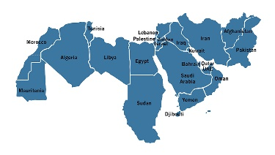
Introduction…
MENA is an acronym which refers to the Middle East and North Africa.
The following countries are normally included in MENA: Algeria, Bahrain, Egypt, Iran, Iraq, Israel, Jordan, Kuwait, Lebanon, Libya, Morocco, Oman, Qatar, Saudi Arabia, Syria, Tunisia, United Arab Emirates, Palestine, and Yemen. Sudan and Turkey are sometimes included in MENA.
Algeria, Egypt, Libya, Morocco, Sudan, and Tunisia are located in Africa, while the rest are located in Asia.
The MENA region accounts for approximately 6% of the world's population, 60% of the world's oil reserves, and 45% of the world's natural gas reserves. Due to the region's substantial petroleum and natural gas reserves, MENA is an important source of global economic stability.
The MENA region is characterized with a young average population age. The median age across the MENA region is 26.8 years old. The younger generation is growing, creating an age bulge and high rates of youth unemployment.
According to the 2019 UN World Population prospects, the following table show the MENA countries ranked by population.
Country | Population
Egypt | 100,388,073
Iran | 82,913,906
Algeria | 43,053,054
Iraq | 39,309,783
Morocco | 36,471,769
Saudi Arabia | 34,268,528
Yemen | 29,161,922
Syrian Arab Republic | 17,070,135
Tunisia | 11,694,719
Jordan | 10,101,694
United Arab Emirates | 9,770,529
Israel | 8,519,377
Lebanon | 6,855,713
Libya | 6,777,452
Palestine | 4,981,420
Oman | 4,974,986
Kuwait | 4,207,083
Qatar | 2,832,067
Bahrain | 1,641,172
The World Bank Group, in its Human Capital Index report released in 2020, cautions that a child born today in the Middle East and North Africa (MENA) will be only 57% as productive when she grows up as she would be if she benefited from complete education and full health. The 2020 index serves as a baseline to track changes in human capital and inform approaches to protecting and investing in people, through the pandemic and beyond.
According to the report, wealthier states of the Gulf Cooperation Council have higher Human Capita Index (HCI) values (between 0.56 and 0.67), while conflict-affected states such as Yemen (0.37) and Iraq (0.41) lag behind.

Slide 7
Introduction…
The analysis finds that some countries — like Morocco, Oman and the United Arab Emirates — have improved their HCI values over the past decade, while others — like Jordan, Kuwait and Tunisia — have remained in place. Overall, countries in MENA tend to perform below countries in other regions at the same income level on the Human Capital Index.
According to the report, gender gaps remain wide in some MENA countries. The Human Capital Index for males (0.55) is lower than that for females (0.59) in MENA as a whole and in most countries in the region. These differences are driven largely by boys' lower educational outcomes, with girls expected to complete more than half of an additional learning-adjusted year of school compared to boys (8.0 for girls versus 7.4 for boys).

Slide 8
Introduction…
Egypt with a population of 106.4 million (July 2021 est.) ranked the 14th in the list of countries with population growth rate of 2.17% (2021 est.) , is characterized as ‘’young’’ in terms of demography with 18.01% of the population in the age group (15-24) as released by the CIA Factbook in 2020 est.
With unemployment of 29.6% among the youth age (15-24) in 2017, that is flipping the opportunity and the asset value of being a “young” population into a zone of potential threat of stability as being young and unemployed.
Among the factors most affecting such threatening rate is the lack of coordination between education and the needs of the labor market. The evidence-based survey of ILO (2018) with full review of EG employment prospects rooted back this phenomenon to the gap between the university graduate skills and competencies and those required by the labor market, with top universities limiting their focus on academic perspective, whereas many (public and private) are focusing on graduating the maximum number of students without clear vision towards the competencies needed for effective engagement in the society and the consequent employment opportunities in a market that is characterized of being most dynamic and is emerging from local to global perspective.
World Youth Forum 2017, 2018 and 2019 in EG declared targeting missing graduates' skills such as social competencies, accepting and embracing diversity in society along with respect to others, communication skills, leadership, social intelligence, analytical skills, as a driving force for community stability and prosperous growth.
The unemployment rate is declining from 2016 till 2019 with 4.6%, in addition to males unemployment rate that decreased with 4.1%.
Females unemployment rate has been fluctuating with a total decline of almost 2%.
“University & Above” is the highest unemployed group with 43.8%, followed by the ‘’Intermediate’’ group with 34.6%.
Which means that the market can not produce enough jobs for the university graduates.
Therefore, university graduates need to develop the skills Set that would match the market needs, or would enable them to create their own opportunities.
Source: CAPMAS

Slide 9
Global Knowledge Index (GKI) - 2020
Covering 138 countries, the GKI provides a systematic tool for guiding and informing policymakers, researchers, civil society and the private sector to collaborate on different aspects of policies to foster knowledge-based societies and bridge knowledge gaps.
Ranks 72 out of 138 countries in the GKI, with a total score of 45/100 – below the global average which stands at 46.7/100.
Egypt is considered as a moderate performer in its knowledge infrastructure.
Rank
Total Score
72
45
Global Entrepreneurial Index (GEI) - 2019
The Global Entrepreneurship Index (GEI) is an annual index that measures the health of the entrepreneurship ecosystems in each of 137 countries. It then ranks the performance of these against each other. This provides a picture of how each country performs in both the domestic and international context.
Egypt’s GEI was at level of 24.6 in 2019, It ranks 81 out of 137 countries.
Rank
Total Score
81
24.6
Global Innovation Index (GII) - 2020
The Global Innovation Index (GII) provides detailed metrics about the innovation performance of 131 countries and economies around the world. Its 80 indicators explore a broad vision of innovation, including political environment, education, infrastructure and business sophistication.
Egypt’s GII was at level of 24.23 in 2020, It ranks 96 out of 131 countries.
Rank
Total Score
96
24.23

Slide 10
Labor Force…
According to the Egyptian Center for Economic Studies (ECES), The proportion of the population in the working age (The percentage of the population in the age groups 15-35) has increased, which puts additional pressure on available job opportunities.
Such a wasted demographic dividend that should be used to mobilize economic activities and sectors.
The recede in demographic pressures is associated to the expected increase in the rate of female participation in the labor force, that is related to diminishing reproduction rates, which contributes to increasing the labor force.
There is a lower female participation in economic activity compared to males, especially in the younger age groups, where male contribution are 3-4 times higher than females, while these differences increase in other age groups.
Lower Egypt governorates are generally having the highest unemployment rates compared to Upper Egypt governorates.
Certain governorates are exceptions, such as Aswan, which has an unemployment rate of 24%, Red Sea Governorate (about 23.5%) and North Sinai Governorate (about 48%); mainly due to the decline in tourism activity and the lower numbers of labor force in these governorates.
The geographical distribution of unemployment rates reflects great disparities between urban and rural areas nationwide, where urban areas having the largest share of unemployment compared to rural areas in general, due to the concentration of industrial activities in urban areas according to the Central Agency for Public Mobilization and Statistics.
Distribution of employment by economic sector 2010 to 2020
Source: Statista

Slide 11
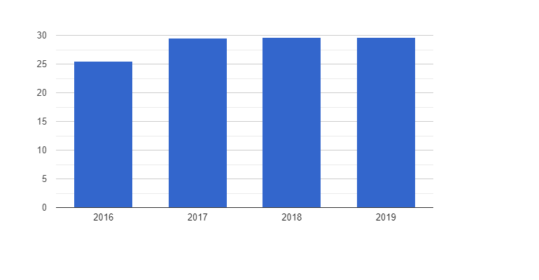
Introduction…
National Statistics Office publishing each year the data relating to the demography of Algeria. Thus, it was estimated on January 1, 2020 that its population was 43,900,000 inhabitants, making it the eighth country in Africa by its demographic weight and thirty-fifth country in the world.
Population growth is causing great pressure on the labor market. The average annual growth of the labor force over the last ten years has been around 1.9 percent while the growth of the population as a whole has been 1.5 percent, meaning the labor market has seen a persistent increase in the number of jobseekers.
Youth unemployment remains high in Algeria. This is apparent from the latest figures released by the National Statistics Office (ONS), In April 2018, the unemployment rate for young people aged 16-24 reached 26.4%.
The link between population wanting to acquire knowledge to improve its standard of living, and the labor market is the university. The university supplies also the economy with the skills necessary for the creation of value.
The LMD reform is being applied against a background of training-public employment decoupling, in a massive university whose graduates experience the highest rate among job seekers (ONS, 2019).
Global Knowledge Index (GKI) - 2020
Algeria was ranked 103rd (out of 138 countries) in the Global Knowledge Index (GKI) for the year 2020 established by the United Nations Development Program (UNDP)
The fields in question are pre-university education, technical and vocational education and training, higher education, research, development and innovation, information and communications technologies, economics and conducive nature of the general environment.
With a score of 37.5, Algeria is well below the world average of 46.7. Algeria’s 103rd place in the world.
Rank: 103
Total Score: 37.5
Algeria: Youth unemployment, ages 15-24 (1991 – 2019)

Slide 12
Global Entrepreneurial Index (GEI) - 2019
The Global Entrepreneurship Index (GEI) is an annual index that measures the health of the entrepreneurship ecosystems in each of 138 countries. It then ranks the performance of these
Rank
Total Score
Against each other. This provides a picture of how each country performs in both the domestic and international context.
88
22.4
Global Innovation Index (GII) - 2020
The Global Innovation Index (GII) ranks world economies according to their innovation capabilities. Consisting of roughly 80 indicators, grouped into innovation inputs and outputs, the GII aims to capture the multi-dimensional facets of innovation. The statistical confidence interval for the ranking of Algeria in the GII 2020 is between ranks 115 and 121.
Algeria ranks 121st among the 131 economies featured in the Gill 2020
Rank
Total Score
121
19.5

Slide 13
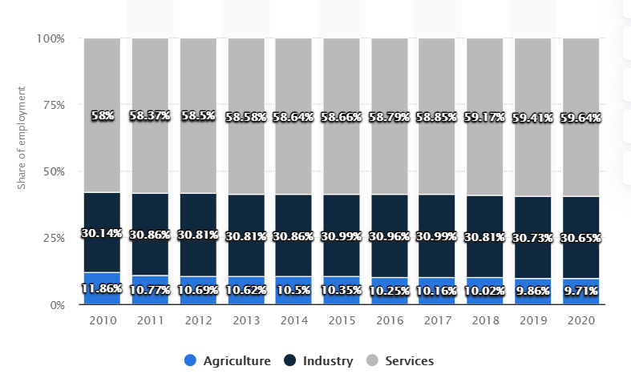
Labor Force…
The labor market in Algeria has improved in the last decade. Compared to the 2000s, the unemployment rate declined significantly and the number of economically active people in the country increased in recent years. .
The labor force in Algeria faces widespread unemployment. Specifically, finding a job is difficult for youth and women.
In 2020, the youth unemployment rate was nearly 30 percent, while 20 percent of the female labor force was not employed. The highly educated population also represented the largest share of unemployed. Furthermore, high levels of informal employment in the country are a relevant concern for the labor market. Informality does not provide job security and even threatens the functioning of the formal sector. In recent months, secure employment has been more important than ever.
One of the challenges facing Algeria was thus to mitigate the inequalities between regions without abandoning its development strategy based on the industrialization of the country in accordance with the principles of market-oriented economies. Néanmoins, le choix a priori du niveau d'emploi est conditionné au niveau et au type de capital existant dans la region
A majority of Algeria’s wilayas, or provinces — namely 36 out of 48 — are situated in the north, between the coast and the high plateau. Over 70 per cent of the population lives in the north, while the remaining twelve wilayas located in the south, which together make up 89 percent of the country’s area, are populated by less than 13 percent of the population.
This uneven geographical distribution is due mainly to the concentration of economic activities in urban areas

Slide 14
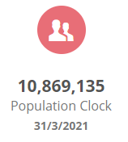
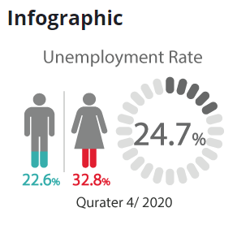
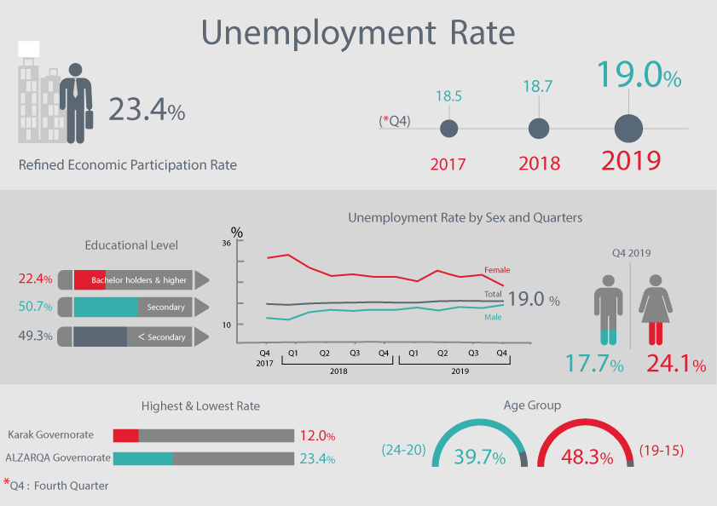
Introduction…
Jordan with a population of 10,869,135 million as Population Clock declare ( http://dosweb.dos.gov.jo ). Jordan is characterized as a “young” country with 34.3% of the population under 15 years old.
Particularly in terms of the unemployment among youth with higher percentage among females compared to males in the age group (18-29). According to the official International Labor Organization website and Department of Statistics, Jordan's unemployment rate has recorded 24.7 in general, 22.6% for males compared to 32.8% for females.
The study of ILO conducted 2016-2018 for Jordan and focusing on different regions within, showed that unemployment for university graduates are record-high in the region (25.6%) among males and (78%) among females according to Jordanian Department of Statistics in its annual report released in the first quarter of 2019.
The unemployment rate is on the rise for both sexes from 2017 (18.5%), 2018 (18.7%), till 2019 with 19.0%, in addition to males unemployment rate that decreased with 4.1%.
While the unemployment rate for the Bachelor holders and the higher education is 22.4% for both sexes.
The unemployment rate according to the age group , the rate is (39.7%) for the age between 20-24.
Being close to zones of political unrest, Jordan has experienced waves of immigrations from Syria over the past decade, who have become a true burden on the Jordanian economy and significantly affecting employment chances for Jordanian graduates.
As per the study of ILO, the only way out for the Jordanian economy is the true and realistic match of the graduate competencies with the competitive job market needs (national or multi-national), which are attracting their major competent working force from countries such as India and China, which possesses a true challenge to the national stability in Jordan. Education reform targeting future job market competence needs is becoming imminent in Jordan more than ever in order to balance the threatening rates of unemployment in one of the most politically dynamic and fragile regions in the World.

Slide 15
Global Knowledge Index (GKI) - 2020
Covering 138 countries, the GKI provides a systematic tool for guiding and informing policymakers, researchers, civil society and the private sector to collaborate on different aspects of policies to foster knowledge-based societies and bridge knowledge gaps.
Rank
Total Score
Ranks 79 out of 138 countries in the GKI, with a total score of 43.9/100 – below the global average which stands at 46.7/100.
Jordan is considered as a moderate performer in its knowledge infrastructure.
79
43.9
Global Entrepreneurial Index (GEI) - 2019
The Global Entrepreneurship Index (GEI) is an annual index that measures the health of the entrepreneurship ecosystems in each of 137 countries. It then ranks the performance of these against each other. This provides a picture of how each country performs in both the domestic and international context.
Jordan’s GEI was at level of 36.5 in 2019, It ranks 49 out of 137 countries.
Rank
Total Score
49
36.5
Global Innovation Index (GII) - 2020
The Global Innovation Index (GII) provides detailed metrics about the innovation performance of 131 countries and economies around the world. Its 80 indicators explore a broad vision of innovation, including political environment, education, infrastructure and business sophistication.
Jordan’s GII was at level of 27.79 in 2020, It ranks 81 out of 131 countries.
Rank
Total Score
81
27.79

Slide 16
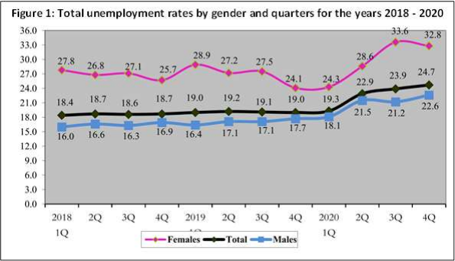
Labor Force…
Unemployment:
1- The results show that the Unemployment Rate has reached (24.7%) during the fourth quarter of 2020; representing an increase by 5.7 percentage points of the fourth quarter 2019.
2- The Unemployment Rate for males has reached (22.6%) during the fourth quarter of 2020 against (32.8%) for females. It becomes clear that the Unemployment Rate has increased for males by 4.9 percentage points and for females by 8.7 percentage points compared with the fourth quarter of 2019.
3- Comparing the unemployment rate for the fourth quarter with the third quarter of 2020 shows that the unemployment rate increased by 0.8 percentage points; males increased by 1.4 percentage points, while it decreased for females by 0.8 percentage points.
The Unemployed:
1- The Survey results show that the Unemployment Rate was high among the university degree holders (Bachelor degree and higher divided by labor force for the same educational level) as it reached 27.8% compared with the other educational levels.
2- The results also show that 51.1% of the Unemployed are secondary certificate holders and higher, and that 48.9% have less than secondary school qualifications.
3- The percentage of the unemployed varied according to educational level and gender. The percentage of unemployed males holding a bachelor’s degree or higher reached 24.5% compared to 75.8% for females.
4- The highest rate of Unemployment was recorded in the age group 15-19 and 20-24 years by 62.1% and 47.9% respectively.
5- The highest Rate of Unemployment was recorded in Tafilah at 26.2% and the lowest rate was recorded in Ajlun at 17.2%.

Slide 17
Objectives

Slide 18
Objectives…
The surveys were conducted to meet the following objectives:
analyze the current skills/ competencies of university graduates from Engineering & technology – ITC in partner countries (Egypt, Jordan and Algeria) as part of the MENA region,
explore employers’ perceptions of the most important skills/competencies that engineering and technology job seekers must have,
examine how the current teaching/learning methodologies at partner institutions affect graduates’ qualifications,
assess the skills gaps between students’ qualifications and employers' expectations,
highlight the recommended set of most needed pool of competences to contribute to skills development programs coherent with labor market demand for engineers and ICT professionals, and
identify the best practices in learning techniques and HE environments that will bridge the gap between students’ qualifications and employers' expectations.
The findings will be the guide for a Gap Analysis of current and future students’ qualifications and the market needed competencies, which will be, in turn, the basis of the design of Student Journey throughout the academic Lifecycle at the university level. This will yield a roadmap mapping targeted competencies with curricular and extra-curricular activities over the academic years, identifying which to be covered in-class and which out-of-class, and which through project-based learning.

Slide 19
Methodology

Slide 20
Research Methodology…
In order to identify key graduates’ competencies as required by the job market and how teaching practices can reduce the competencies gap, 3 different survey questionnaires were designed and administrated in partner countries to targeted participants through SurveyMonkey, an online survey development cloud-based software. The surveys were disseminated online because of the current pandemic situation, and remained open from to.
The 3 surveys were:
1.1) Survey on current students’ qualifications: current university graduate skills, qualifications and competencies in the partner countries in the project with and overview of those in the countries in MENA region. This survey was disseminated among senior university students of and graduates from Engineering & technology – ITC.
1.2) Survey on regional job-market needed graduates’ competencies in each partner country and what the employers are seeking in fresh graduates. This survey was distributed among employers, managers, trainers, and HR personnel in two different market segments – engineering and technology.
1.3) Survey on current teaching/learning methodologies at particular partner institutions that had led to the outcomes in 1.1. This survey was administrated to universities’ faculty members at partner universities.
In Survey 1.1, questions were organized to capture the following information:
Demographics including country, gender, age, higher institute type, education level, and tenure
How adequate was the education received at university level to the job market needs on a scale (very much; much; some; little; very little)
The employment potential of degree programmes from the viewpoint of the students/graduates
The level of which each skill/competence was covered by the degree programme (On scale: 1= none; 2=weak; 3-considerable; 4=strong; 5=very strong) from the viewpoint of the students/graduates
In Survey 1.2, questions aimed at identifying:
The importance of the assessed skills/competencies for work in Engineering & technology – ITC fields (On scale: 1= none; 2=weak; 3-considerable; 4=strong; 5=very strong) from the point of view of employers or those in a position to identify this like trainers, managers and HR personnel.
Open-ended questions were included to give participants to identify any additional key competencies that may have been omitted but were thought to be important, difficulties in selecting university graduates and platforms used to find skilled employees.

Slide 21
Research Methodology…
In Survey 1.3, questions were designed to:
Identify how teaching activities and methodologies affect the assessed skills/competencies in universities at partner countries.
A descriptive survey method was used as it allows posing a series of questions to participants, summarizing their responses with percentages and statistics, and drawing inferences from their responses.
The design of the questionnaire was validated by career experts and tested with a small group of undergraduate senior students majoring in engineering and computer science.
Assessed Skills/ competencies
Personal Skills
Social Skills
Planning and time management
Critical thinking
Capacity to adapt to new situations
Capacity for generating new ideas (creativity)
Problem-solving
Decision-making
Ability to work independently
Initiative and entrepreneurial spirit
Ability to work under pressure
Oral and written communication in other languages (especially English)
Teamwork
Leadership & Coordination
Ability to work in an interdisciplinary team
Appreciation of diversity and multi-culturality; understanding of cultures and customs of other countries; ability to work in an intercultural environment
Communication at all levels and interpersonal skills
Analytical Skills
Cognitive Skills
Information management skills (ability to retrieve and analyze information from different sources)
Data gathering & interpretation
Testing solutions and new ideas based on previous experiences and gained knowledge
Ability to create post-analysis and reviewing what solutions worked to asses and apply new knowledge
Capacity to learn
Ability to multitask
Capacity to follow specific rules
Ability to analyze problems and evaluate options
Intellectual Skills
Grounding in basic knowledge of the profession in practice
Research skills
Digital competencies and computer skills

Slide 22
Data Collection Process…
Once the questionnaires in English were ready, it was decided to introduce a translation of Arabic to the questions in the same survey. After this, each partner, academic and non-academic, decided the process to move to the data collection in the most convenient way for each context, taking into account the restrictions of the pandemic situation and the exams timeline.
Survey 1.1 and 1.3 were disseminated among senior students, graduates and faculty members in partner countries’ universities. It was circulated among public, private and national universities alike to guarantee the coverage of different learners’ competencies and learning methodologies. Academic partners
Survey 1.2 was distributed among employers, managers, trainers, recruitment agencies personnel and HR managers in engineering and ICT fields

Slide 23
Ranking (EU vs. MENA) – Survey 1.1
 | EU | MENA
Ranking from most important to least important | Personal Skills
 | Ability to work independently | Ability to work under pressure
 | Capacity to adapt to new situations | Problem-solving
 | Critical Thinking | Capacity to adapt to new situations
 | Problem-solving | Ability to work independently
 | Decision-making | Decision-making
 | Planning and time management | Capacity for generating new ideas (creativity)
 | Capacity for generating new ideas (creativity) | Critical Thinking
 | Ability to work under pressure | Initiative and entrepreneurial spirit
 | Initiative and entrepreneurial spirit | Planning and time management
 | Social Skills
 | Teamwork | Teamwork
 | Oral and written communication in other languages (especially English) | Ability to work in an interdisciplinary team
 | Appreciation of diversity and multi-culturality; understanding of cultures and customs of other countries; ability to work in an intercultural environment | Appreciation of diversity and multi-culturality; understanding of cultures and customs of other countries; ability to work in an intercultural environment
 | Communication at all levels and interpersonal skills | Communication at all levels and interpersonal skills
 | Leadership & Coordination | Leadership & Coordination
 | Ability to work in an interdisciplinary team | Oral and written communication in other languages (especially English

Slide 24
Ranking (EU vs. MENA) – Survey 1.1
 | EU | MENA
Ranking from most important to least important | Analytical Skills
 | Information management skills (ability to retrieve and analyze information from different sources) | Data gathering & interpretation
 | Data gathering & interpretation | Information management skills (ability to retrieve and analyze information from different sources)
 | Testing solutions and new ideas based on previous experiences and gained knowledge | Testing solutions and new ideas based on previous experiences and gained knowledge
 | Ability to create post-analysis and reviewing what solutions worked to asses and apply new knowledge | Ability to create post-analysis and reviewing what solutions worked to asses and apply new knowledge
 | Cognitive Skills
 | Ability to analyze problems and evaluate options | Capacity to learn
 | Capacity to learn | Capacity to follow specific rules
 | Capacity to follow specific rules | Ability to multitask
 | Ability to multitask | Ability to analyze problems and evaluate options
 | Intellectual Skills
 | Digital competencies and computer skills | Research skills
 | Research skills | Digital competencies and computer skills
 | Grounding in basic knowledge of the profession in practice | Grounding in basic knowledge of the profession in practice

Slide 25
Ranking (EU vs. MENA) – Survey 1.2
 | EU | MENA
Ranking from most important to least important | Personal Skills
 | Capacity to adapt to new situations | Problem-solving
 | Problem-solving | Capacity for generating new ideas (creativity)
 | Critical Thinking | Capacity to adapt to new situations
 | Planning and time management | Ability to work under pressure
 | Ability to work independently | Initiative and entrepreneurial spirit
 | Initiative and entrepreneurial spirit | Planning and time management
 | Ability to work under pressure | Decision-making
 | Capacity for generating new ideas (creativity) | Ability to work independently
 | Decision-making | Critical Thinking
 | Social Skills
 | Ability to work in an interdisciplinary team | Teamwork
 | Communication at all levels and interpersonal skills | Ability to work in an interdisciplinary team
 | Teamwork | Leadership & Coordination
 | Appreciation of diversity and multi-culturality; understanding of cultures and customs of other countries; ability to work in an intercultural environment | Appreciation of diversity and multi-culturality; understanding of cultures and customs of other countries; ability to work in an intercultural environment
 | Oral and written communication in other languages (especially English) | Oral and written communication in other languages (especially English)
 | Leadership & Coordination | Communication at all levels and interpersonal skills

Slide 26
Ranking (EU vs. MENA) – Survey 1.2
 | EU | MENA
Ranking from most important to least important | Analytical Skills
 | Information management skills (ability to retrieve and analyze information from different sources) | Data gathering & interpretation
 | Ability to create post-analysis and reviewing what solutions worked to asses and apply new knowledge | Testing solutions and new ideas based on previous experiences and gained knowledge
 | Testing solutions and new ideas based on previous experiences and gained knowledge | Information management skills (ability to retrieve and analyze information from different sources)
 | Data gathering & interpretation | Ability to create post-analysis and reviewing what solutions worked to asses and apply new knowledge
 | Cognitive Skills
 | Ability to analyze problems and evaluate options | Capacity to learn
 | Capacity to learn | Ability to analyze problems and evaluate options
 | Capacity to follow specific rules | Ability to multitask
 | Ability to multitask | Capacity to follow specific rules
 | Intellectual Skills
 | Digital competencies and computer skills | Grounding in basic knowledge of the profession in practice
 | Research skills | Digital competencies and computer skills
 | Grounding in basic knowledge of the profession in practice | Research skills

